Slide 1
SPATIAL DATA STRUCTURES –KD-TREES
Jianping Fan
Department of Computer Science
UNC-Charlotte

Slide 2
SUMMARY
This lecture introduces multi-dimensional queries in databases, as well as addresses how we can query and represent multi-dimensional data
“A reasonable man adapts himself to his environment. An unreasonable man persists in attempting to adapt his environment to suit himself …Therefore, all progress depends on unreasonable man”
George Bernard Shaw

Slide 3
CONTENTS
Definitions
Basic operations and construction
Range queries on multi-attributes
Variants
Applications

Slide 4
USAGE
Rendering
Surface reconstruction
Collision detection
Vision and machine learning
Intel Interactive technology

Slide 5
KD TREE DEFINITION
A recursive space partitioning tree.
– Partition along x and y axis in an alternating fashion.
– Each internal node stores the splitting node along x (or y).

Slide 6
K-D TREE
Used for point location and multiple database quesries, k –number of the attributes to perform the search
Geometric interpretation – to perform search in 2D space – 2-d tree
Search components (x,y) interchange!

Slide 7
K-D TREE EXAMPLE
d
d
e
c
b
f
f
c
a
e
b
a

Slide 8
CONSTRUCTION
The canonical method of kd-tree construction is the following:
As one moves down the tree, one cycles through the axes used to select the splitting planes. (For example, the root would have an x-aligned plane, the root's children would both have y-aligned planes, the root's grandchildren would all have z-aligned planes, the next level would have an x-aligned plane, and so on.)
Points are inserted by selecting the median of the points being put into the subtree, with respect to their coordinates in the axis being used to create the splitting plane. (Note the assumption that we feed the entire set of points into the algorithm up-front.)

Slide 9
CONSRUCTION
This method leads to a balanced kd-tree, in which each leaf node is about the same distance from the root. However, balanced trees are not necessarily optimal for all applications.
Note also that it is not required to select the median point. In that case, the result is simply that there is no guarantee that the tree will be balanced. A simple heuristic to avoid coding a complex linear-time median-finding algorithm or using an O(n log n) sort is to use sort to find the median of a fixed number of randomly selected points to serve as the cut line

Slide 10
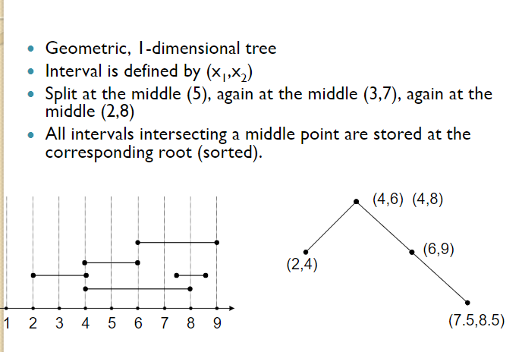
K-D TREE EXAMPLE

Slide 11
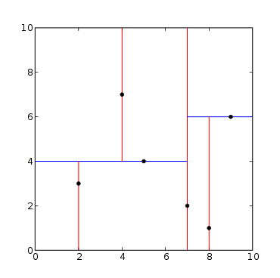
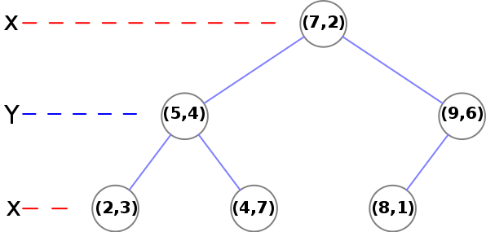
KD TREE EXAMPLE

Slide 12
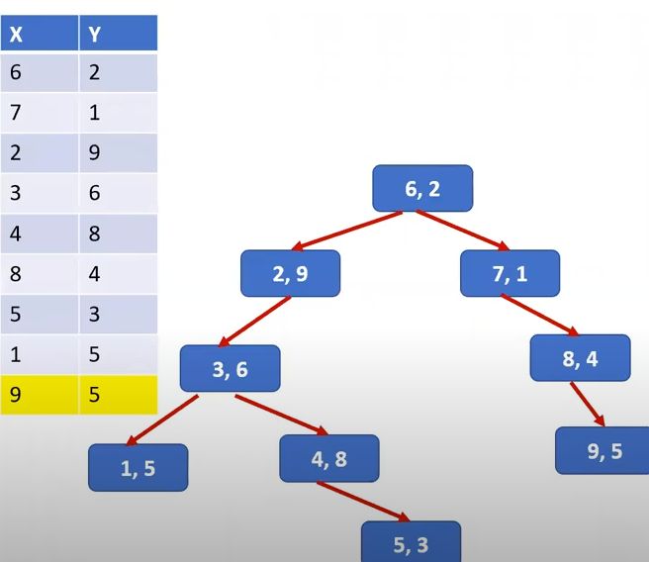
KD TREE EXAMPLE

Slide 13
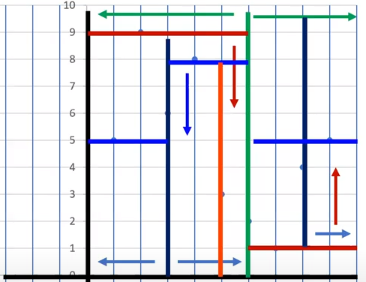
KD TREE PARTITION SPACE

Slide 14
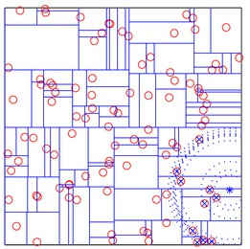
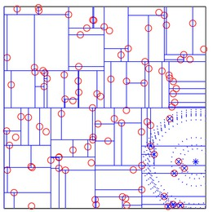
KD TREE – MEAN VS MEDIAN
kd-tree partitions of a uniform set of data points, using the mean (left image) and the median (right image) thresholding options. Median: The middle value of a set of values. Mean: The arithmetic average.
(Andrea Vivaldi and Brian Fulkersson)
http://www.vlfeat.org/overview/kdtree.html

Slide 15
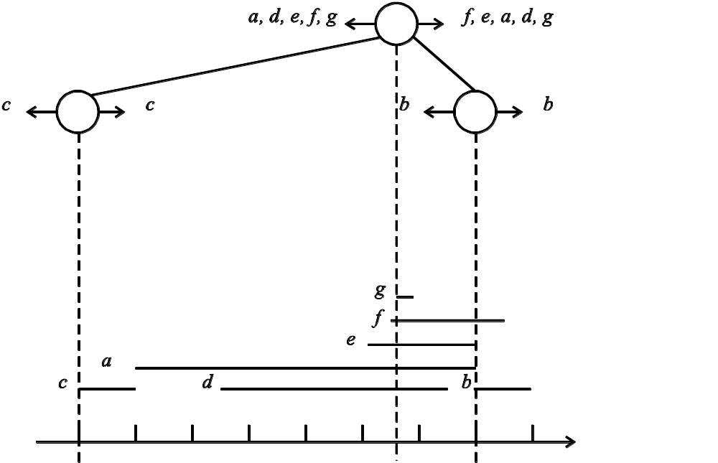
EXAMPLE OF USING MEDIAN

Slide 16
ADDITIONS
One adds a new point to a kd-tree in the same way as one adds an element to any other search tree.
First, traverse the tree, starting from the root and moving to either the left or the right child depending on whether the point to be inserted is on the "left" or "right" side of the splitting plane.
Once you get to the node under which the child should be located, add the new point as either the left or right child of the leaf node, again depending on which side of the node's splitting plane contains the new node.
Adding points in this manner can cause the tree to become unbalanced, leading to decreased tree performance

Slide 17
DELETIONS
To remove a point from an existing kd-tree, without breaking the invariant, the easiest way is to form the set of all nodes and leaves from the children of the target node, and recreate that part of the tree.
Another approach is to find a replacement for the point removed. First, find the node R that contains the point to be removed. For the base case where R is a leaf node, no replacement is required. For the general case, find a replacement point, say p, from the sub-tree rooted at R. Replace the point stored at R with p. Then, recursively remove p.

Slide 18
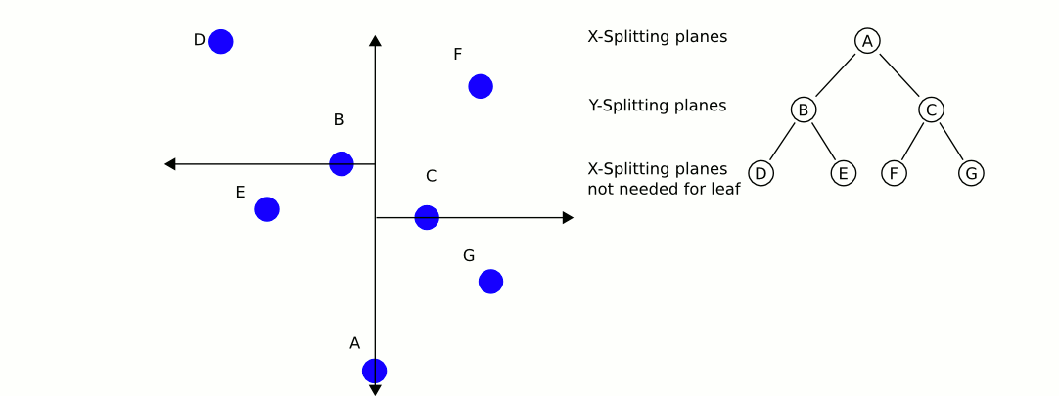
KD TREE
http://upload.wikimedia.org/wikipedia/en/9/9c/KDTree-animation.gif

Slide 19
COMPLEXITY
Building a static kd-tree from n points takes O(n log ² n) time if an O(n log n) sort is used to compute the median at each level.
The complexity is O(n log n) if a linear median-finding algorithm such as the one described in Cormen et al.] is used.
Inserting a new point into a balanced kd-tree takes O(log n) time.
Removing a point from a balanced kd-tree takes O(log n) time.
Querying an axis-parallel range in a balanced kd-tree takes O(n^{1-1/k} +m) time, where m is the number of the reported points, and k the dimension of the kd-tree.

Slide 20
APPLICATIONS
Query processing in sensor networks
Nearest-neighbor searchers
Optimization
Ray tracing
Database search by multiple keys

Slide 21
DECISION TREE
Database indexing structure is built for decision making and tries to make the decision as fast as possible!
Color = Green?
yes
no
Size = Big?
Color = Yellow?
yes
yes
no
no
watermelon
Shape = Round?
Size = small?
Size = Medium?
yes
no
yes
no
yes
no
Size = Big?
banana
apple
Taste = sweet?
apple
yes
no
yes
no
Grape
grapefruit
lemon
cherry
grape

Slide 22
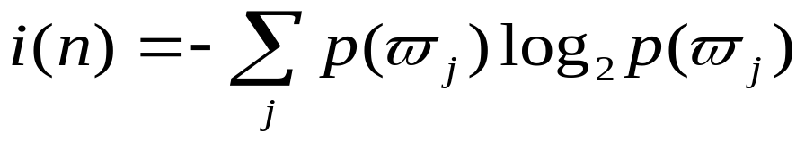
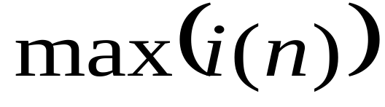
DECISION TREE
How to obtain decision for a database?
Obtain a set of labeled training data set from the database.
Calculate the entropy impurity:
c. Classifier is built by:

Slide 23
KD-TREE
By treating query as a decision making procedure, we can use decision to build more effective database indexing!
Database root node
no
Salary > $75000?
Age > 60?
yes
no
yes
no
Age > 60?
Data table
yes
no

Slide 24
KD-TREE
Each inter-node, only one attribute is used!
It is not balance! Search from different node may have different I/O cost!
It can support multiple attribute database indexing like R-tree!
It has integrated decision making and database query!

Slide 25
KD-TREE
Tree levels: N; Leaf nodes: M; Number of data entries for leaf node: K
The inter-nodes for kd-tree at the same level are stored on the same page.
Equal query: N + M
Range query: N + M
Insert: N + M + 1
Delete: N+ M + 1

Slide 26
STORAGE MANAGEMENT FOR HIGH-DIMENSIONAL INDEXING STRUCTURES
We want to put the similar data in the same page or neighboring pages!
Index entries
UNCLUSTERED
CLUSTERED
direct search for
UNCLUSTERED
Index entries
CLUSTERED
data entries
direct search for
data entries
Data entries
Data entries
Data entries
(Index File)
Data entries
(Data file)
(Index File)
(Data file)
Data Records
Data Records
Data Records
Data Records

Slide 27
ALSO REFER,
- THEORY / EXAMPLES DISCUSSED IN LECTURE
- E-BOOK, COMPUTATION GEOMETRY UPLOADED IN MS-TEAMS

